Slide 1
Sociology Course Code (SS 2005)
Muhammad Zeeshan

Slide 2
Deviance, Crime
Deviance is the recognized violation of cultural norms.
One category of deviance is crime, the violation of a society’s formally enacted criminal law e.g burglary, theft, killing, injuring, fraud etc.
social control, attempts by society to regulate people’s thoughts and behavior
criminal justice system, the organizations—police, courts, and prison officials—that respond to alleged violations of the law.

Slide 3
The Biological Context and Personality Factors
A century ago, most people assumed—incorrectly, as it turns out—that human behavior was the result of biological instincts. Early interest in criminality therefore focused on biological causes.
Like biological theories, psychological explanations of deviance focus on abnormality in the individual personality. Some personality traits are inherited, but most psychologists think that personality is shaped primarily by social experience. Deviance, then, is viewed as the result of “unsuccessful” socialization.

Slide 4
The Social Foundations of Deviance :-
Deviance varies according to cultural norms.
People become deviant as others define them that way
How societies set norms and how they define rule breaking both involve social power.

Slide 5
Durkheim’s Basic Insight
In his pioneering study of deviance, Emile Durkheim (1964a, orig. 1893; 1964b, orig. 1895) made the surprising claim that there is nothing abnormal about deviance. In fact, it performs four essential functions:
1. Deviance affirms cultural values and norms. As moral creatures, people must prefer some attitudes and behaviors to others. But any definition of virtue rests on an opposing idea of vice: There can be no good without evil and no justice without crime. Deviance is needed to define and support morality.
2. Responding to deviance clarifies moral boundaries. By defining some individuals as deviant, people draw a boundary between right and wrong. For example, a college marks the line between academic honesty and cheating by disciplining students who cheat on exams.

Slide 6
3. Responding to deviance brings people together. People typically react to serious deviance with shared outrage. In doing so, Durkheim explained, they reaffirm the moral ties that bind them. For example, after the January 2011 shooting rampage in Tucson, Arizona, that killed six people and wounded nineteen more, including Congressional Representative Gabrielle Giffords, people across the United States were joined by a common desire to control this type of apparently senseless violence.
4. Deviance encourages social change. Deviant people push a society’s moral boundaries, suggesting alternatives to the status quo and encouraging change. Today’s deviance, declared Durkheim, can become tomorrow’s morality (1964b:71, orig. 1895). For example, rock-and-roll, condemned as immoral in the 1950s, became a multibillion-dollar industry just a few years later (see the Thinking About Diversity box on page 68). In recent years, hip-hop music has followed the same path toward respectability.

Slide 7
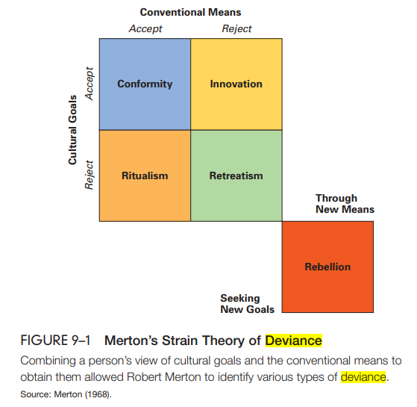
Merton’s Strain Theory

Slide 8
Labeling Theory
The main contribution of symbolic-interaction analysis is labeling theory, the idea that deviance and conformity result not so much from what people do as from how others respond to those actions. Labeling theory stresses the relativity of deviance, meaning that people may define the same behavior in any number of ways.

Slide 9
Sutherland’s Differential Association Theory
Learning any behavioral pattern, whether conventional or deviant, is a process that takes place in groups. According to Edwin Sutherland (1940), a person’s tendency toward conformity or deviance depends on the amount of contact with others who encourage or reject conventional behavior. This is Sutherland’s theory of differential association.

Slide 10
Hirschi’s Control Theory
The sociologist Travis Hirschi (1969; Gottfredson & Hirschi, 1995) developed control theory, which states that social control depends on people anticipating the consequences of their behavior. Hirschi assumes that everyone finds at least some deviance tempting. But the thought of a ruined career keeps most people from breaking the rules; for some, just imagining the reactions of family and friends is enough. On the other hand, individuals who feel they have little to lose by deviance are likely to become rule breakers.

Slide 11
Specifically, Hirschi links conformity to four different types of social control:
Attachment. Strong social attachments encourage conformity. Weak family, peer, and school relationships leave people freer to engage in deviance.
Opportunity. The greater a person’s access to legitimate opportunity, the greater the advantages of conformity. By contrast, someone with little confidence in future success is more likely to drift toward deviance.
Involvement. Extensive involvement in legitimate activities— such as holding a job, going to school, or playing sports—inhibits deviance (Langbein & Bess, 2002). By contrast, people who simply “hang out” waiting for something to happen have time and energy to engage in deviant activity.
Belief. Strong belief in conventional morality and respect for authority figures restrain tendencies toward deviance. People who have a weak conscience (and who are left unsupervised) are more open to temptation (Stack, Wasserman, & Kern, 2004).

Slide 12
TYPES OF CRIME
White-collar crime, defined by Edwin Sutherland (1940) as crime committed by people of high social position in the course of their occupations.
Sometimes whole companies, not just individuals, break the law. Corporate crime is the illegal actions of a corporation or people acting on its behalf.
Organized crime is a business supplying illegal goods or services.
A hate crime is a criminal act against a person or a person’s property by an offender motivated by racial or other bias.
Crimes against the person, also called violent crimes, are crimes that direct violence or the threat of violence against others
Crimes against property (property crimes) crimes that involve theft of money or property belonging to others
Victimless crimes, violations of law in which there are no obvious victims. Also called crimes without complaint, they include illegal drug use, prostitution, and gambling.

Slide 13
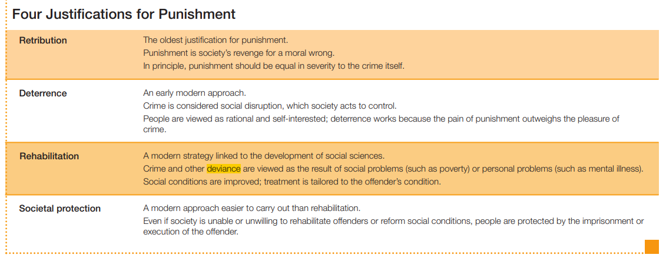

Slide 14
Q&A Session

